Slide 1
Step 8 Azure Monitor

Slide 2
Goal
Understand the monitoring capabilities offered by Azure Monitor.
Understand where Azure Monitor fit in the Azure monitoring solution

Slide 3
What is Azure Monitor?
Provides base-level metrics and logs from Azure infrastructure (Activity Log) and each individual Azure resource (Diagnostic Logs).
Let you visualize, querying, routing and alerting.
Single stop for everything about monitoring ( landing page)

Slide 4
Confusing?
APPINSIGHTS VS AZURE MONITOR VS OMS
Notes:
Application Insights : offers rich detection and diagnostics for issues at the application layer of your service. This is about YOUR code and how well it runs.
Azure Monitor : Offers visualization, query, routing, alerting, autoscale, and automation on data both from the Azure infrastructure (Activity Log) and each individual Azure resource (Diagnostic Logs). It was previously known as "Azure Insights" to confuse matters more :)
Operations Management Suite : "The one dashboard to rule them all", OMS can be used to monitor and manage infrastructure on Azure, on-premises and third-party cloud-based infrastructure (AWS and Google Cloud). Azure Monitor and Application Insights data can be routed directly to Log Analytics so you can see metrics and logs for your entire environment in one place.

Slide 5
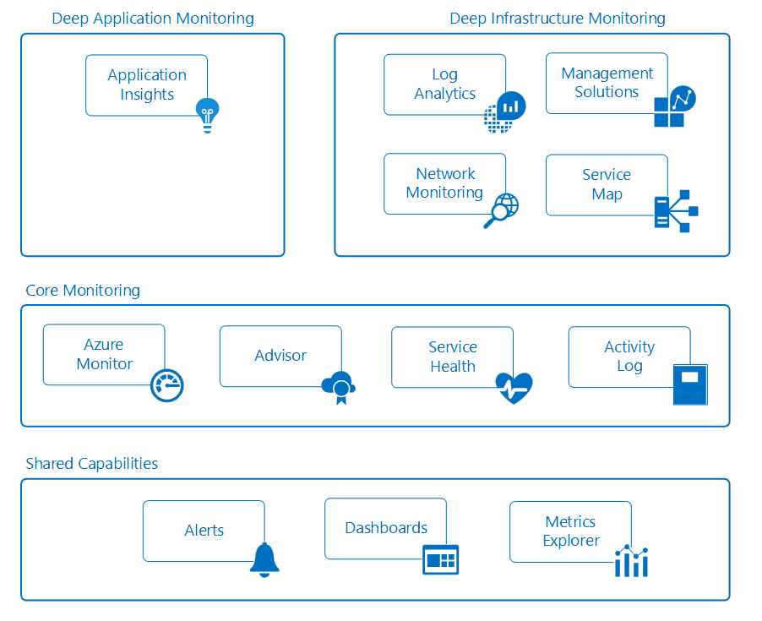

Slide 6
Azure Monitor telemetry pipeline can connect to your Azure services to pull telemetry data.
3 categories of monitoring data
Activity logs
Diagnostic logs
Metrics

Slide 7
Let’s see this in action https://bit.ly/2Eu50W1

